Slide 1

SIT - COMMON CAV SCENARIOS
Presented to: CAV Symposium
Presented by:
N85 - SIT Team

Slide 2
Agenda
  Proof of Shipment – Issues and Solutions
  Outbound SIT – Issues and Solutions
  Inbound SIT – Issues and Solutions
  Classified SIT – Issues and Solutions
  References
Notes:
Here is today’s agenda. I’m going to explain what SIT is, why it’s important to you, and we’ll review some common issues/errors that we see on a regular basis and how to avoid them in the future.

Slide 3
Proof of Shipment
SIT Scenarios

Slide 4
Proof of Shipment (POS) – SIT Scenarios
  Scenario 1 - Non-ATAC Enabled Vendors
  If you are not using ATAC, you must enter shipping data (POS) in CAV RP.
  Scenario 2 - ATAC Enabled Vendors (CANCEL entered in Pick-Up DODAAC)
  The CAV Reporter is responsible for entering POS in CAV RP if CANCEL is entered in the Pick-Up DODAAC.
  Scenario 3 - Local Delivery
  The CAV Reporter is responsible for entering POS/POD in CAV RP if using Local Delivery methods. This includes all of the usual POS info. as well as the name of the final destination receiver in the tracking number field.
Notes:
As we already discussed, if a shipment is transported using ATAC, you will not have to post POS in CAV. The exception to this rule is if you enter CANCEL in the Pick-up DODAAC field in CAV or if you aren’t using ATAC. Both of these scenarios require the CAV Vendor to post POS in CAV.

Slide 5
Proof of Shipment (POS)
Scenario 1 & 2 Solution
  Scenario 1 - Non-ATAC Enabled Vendors and
  Scenario 2 - ATAC Enabled Vendors (CANCEL entered in Pick-Up DODAAC)
  SOLUTION:
  The CAV Reporter shall enter the following shipping data (POS) in CAV RP.
    Transportation Control Number (TCN) of the shipment
    Freight Carrier Company Name or Standard Carrier Alpha Code (SCAC)
    Freight Carrier tracking number (referred to as Pro Number or Tracking Number)
    Date shipped
    Quantity shipped
  The CAV Reporter shall ship all Navy-owned Depot Level Repairables (DLRs) via traceable means. The definition of “traceable means” is any shipping process that mandates signature for transfer of custody.
  It is recommended that you take a screenshot of any tracking data (POS/POD) as a Key Supporting Document (KSD), since tracking numbers often expire.
Notes:
DELETE?
Here is the data that the CAV Keystroker must report in CAV if a non-ATAC freight carrier is used:
TCN, Freight Carrier Name (SCAC), Tracking #, Shipping Date and Qty. Shipped
The CAV Reporter shall ship all Navy-owned DLR’s via traceable means. The definition of “traceable means” is any shipping process that mandates signature for transfer of custody.

Slide 6
Proof of Shipment (POS)
Scenario 3 Solution
  Scenario 3 - Local Delivery
  Local Delivery (LCDL) – custody transferred directly from issuer to final destination
    If a shipment is delivered by the CAV Reporter directly to final destination (local delivery) without utilizing a freight carrier, the CAV Reporter shall provide POD as follows:
  Transportation Control Number (TCN) of the shipment
  Freight Carrier Company Name “Local Delivery”
  Date shipped
  Quantity shipped
  Date delivered
  Signature of the receiver's representative at final destination (reported in CAV POS in the "Tracking Number" field with no imbedded spaces or punctuation)
  ***LCDL without a signature and delivery date is considered incomplete tracking data.***
Notes:
Delivery to occur prior to entering POS/POD for local delivery.
Here is the data that the CAV Keystroker must report in CAV if a non-ATAC freight carrier is used:
TCN, Freight Carrier Name (SCAC), Tracking #, Shipping Date and Qty. Shipped
The CAV Reporter shall ship all Navy-owned DLR’s via traceable means. The definition of “traceable means” is any shipping process that mandates signature for transfer of custody.

Slide 7
SIT POS Data Guide
Local Delivery
Not Local Delivery
  Custody transfers from issuer to final destination.
  Mandatory Data
    Ship Date
    Ship To UIC
    TCN
    Mode = 9
    SCAC Code = LCDL
    Shipper RIC
    Shipped Qty.
    Delivery Date
    Delivery Signature (from final destination)
  Custody transfers from issuer to delivery agent.
  Mandatory Data
    Ship Date
    Ship To UIC
    TCN
    Mode = NEVER 9 (T for ATAC)
    Tracking Number (N/A for ATAC)
    SCAC Code (which delivery agent?)
    Shipper RIC
    Shipped Qty.
Notes:
This slide is just showing the difference between what info. is required to close POS for Local Delivery vs. Not Local Delivery, so you could use this as a cheat-sheet at your desk. Again the difference here will be the SCAC, which will say LCDL for Local Delivery, the Delivery Date and Signature from Final Destination.

Slide 8
Outbound SIT
Scenarios

Slide 9
Outbound SIT Scenarios
  Scenario 1 – Issues to the Fleet Under a Non-Fleet Document Number
  Fleet activities CANNOT receipt for material that is not issued on their own document/requisition number
  Scenario 2 – Incorrect Paperwork/Bulk Shipments
  Always make sure to include the DD-1348 on the inside and outside of all shipments
  *Per the CAV SOW, “…the Contractor is required to report shipment transactions in CAV 24 HOURS PRIOR to the physical shipment of material.”
Notes:
As we already discussed, if a shipment is transported using ATAC, you will not have to post POS in CAV. The exception to this rule is if you enter CANCEL in the Pick-up DODAAC field in CAV or if you aren’t using ATAC. Both of these scenarios require the CAV Vendor to post POS in CAV.

Slide 10
Outbound SIT
Scenario 1 Solution
  Scenario 1 – Issues to the Fleet Under a Non-Fleet Document Number
  SOLUTION:
  For repaired assets going from the Vendor to the Fleet,
    It is imperative to use the correct Fleet requisition/document number, fund code, advice code, etc.
    WSS Supply Planner should provide the Fleet requisition number to be used as the “Shipment Document Number” in CAV RP.
    Material should NEVER be sent to the Fleet on a RCDN.
    Material should NEVER be sent to the Fleet on a RDO.
    Fleet activities CANNOT receipt for material that is not issued on their own document/requisition number (document number begins with their UIC).
    All exceptions should be approved by WSS SIT and/or CAV Analysts.
Notes:
Now we’ll review some common errors that we see with Outbound issues initiated by the CAV Vendor.
If the Vendor is sending repaired material directly to the Fleet the Doc number should not start with your UIC or an RCDN. The Fleet can only receipt for material when the document number begins with their UIC.
Redistribution Orders, which we discussed earlier, will always start with N00383 or N00104. These document numbers should never be used to send material directly to the Fleet.
All outbound issues going directly to the Fleet must use a document number that begins with the Fleet’s UIC. This document number will be provided by the Supply Analyst. Please make sure to use the correct info. for these issues, including Fleet requisition/Document #, Fund Code and Advice Code.
The requisition number provided by the Supply Planner should be used as the Shipment Doc Number in CAV.
Any exceptions to these rules should be approved by the SIT/CAV Analyst.
When returning retrograde (broken parts) to the Fleet, the CAV Vendor must work with the Supply Planner, and the SIT analyst to make arrangements prior to issuing material.

Slide 11
Outbound SIT
Scenario 2 Solution
  Scenario 2 – Incorrect Paperwork/Bulk Shipments
  SOLUTION:
  All issues should include the DD1348 on both the inside and outside of the box.
  Bulk shipments
    Attach DD1348 with one Document Number (RCDN) to all boxes so all items are received under one Document Number
    Keep all shipments to a maximum of 10 RCDNs per Ship Document Number
    Per the CAV SOW…Bulk Shipment (more than qty 1 of the same NIIN in the same shipping container) –The Contractor will place one copy of the DD Form 1348-1A inside each individual unit container. A second copy of the DD Form 1348-1A will be attached to the outside of the individual unit container within the multi-pack. A third copy of the DD Form 1348-1A will be attached to the outside of the multi-pack container.
  Do not use a DD-1149 or a DD-250 for outbound SIT issues, only use a DD1348
    Per the CAV SOW…DD Form 1348-1A is the only authorized shipment document for CAV Reporting. DD Form 250 and DD 1149 are not permitted to accompany material shipments from CAV reporting contracts. To include forms other than DD Form 1348-1A with a CAV shipment causes confusion for the users at the ship-to facility and contributes to unmatched SIT tracking.
Notes:
Some other Outbound issues to be aware of:
The CAV reporter must report shipment transactions in CAV 24 hours prior to physical shipment of material.
All issues should include a DD1348 on both the inside and outside of the box.
Bulk shipments should all use the same RCDN on the 1348 so that they are received under one document number
Do not use 1149s for outbound issues this is not a tracking document. You must use a DD1348.

Slide 12
Inbound SIT
Scenarios

Slide 13
Inbound SIT Scenarios
  Scenario 1 – Redistribution Orders (RDOs)
  Receipts are incorrectly processed in CAV RP under the WRONG document number.
  SDRs not being completed in *7 day timeframe for missing material (ex. RDO Qty. is for 10 but only 9 assets are received)
  Scenario 2 – Misidentified/Misdirected Assets
  Shipment to your site contains one of the following:
    NIIN you can’t identify
    NIIN you don’t repair
    NIIN for which you don’t have an open Contract
  Scenario 3 – Receipt Reversals
  Reversal of receipt in WebCAV that reopens SIT
  *Per CAV SOW FY 2025 – effective 1 OCT
Notes:
As I’ve mentioned several times, RDO document numbers will always start with N00383 or N00104.
These document numbers are initiated by WSS Supply Planners.
The majority of RDOs will be coming from a Defense Depot to a CAV Vendor.
We often see open SIT for RDO documents and the Vendor’s request the serial numbers that were shipped under this document. The DD’s do not track assets by serial number, therefore we do not have this info. readily available.
The SIT Team can sometimes find these serial numbers but not 100% of the time and the process can be very lengthy.
So in order to stay on top of RDOs on your open SIT, please receipt in a timely manner, make sure you’re receiving under the correct document number and contact your CAV Analyst if you have any questions about this process. This type of SIT in particular becomes much more difficult to close with age, so time is of the essence.
E&Y will count an incorrectly receipted RDO as 2 infringements: 1 for the RDO document that will still be open and one for the unmatched receipts posted in CAV under the wrong document number.

Slide 14
Inbound SIT
Scenario 1 Facts
  Scenario 1 - Redistribution Orders (RDOs)
  FACTS
  The document number will begin with N00383 (PHIL/AVIATION) or N00104 (MECH/MARITIME).
  Initiated by Supply Planners at WSS Philadelphia and WSS Mechanicsburg.
  Majority of RDO movement is inbound from a Defense Depot (DD)
  RDO documentation will NOT have serial numbers
    Locating serial numbers is NOT ALWAYS possible
    When it is possible it is a lengthy process
Notes:
As I’ve mentioned several times, RDO document numbers will always start with N00383 or N00104.
These document numbers are initiated by WSS Supply Planners.
The majority of RDOs will be coming from a Defense Depot to a CAV Vendor.
We often see open SIT for RDO documents and the Vendor’s request the serial numbers that were shipped under this document. The DD’s do not track assets by serial number, therefore we do not have this info. readily available.
The SIT Team can sometimes find these serial numbers but not 100% of the time and the process can be very lengthy.
So in order to stay on top of RDOs on your open SIT, please receipt in a timely manner, make sure you’re receiving under the correct document number and contact your CAV Analyst if you have any questions about this process. This type of SIT in particular becomes much more difficult to close with age, so time is of the essence.
E&Y will count an incorrectly receipted RDO as 2 infringements: 1 for the RDO document that will still be open and one for the unmatched receipts posted in CAV under the wrong document number.

Slide 15
Inbound SIT
Scenario 1 Issues
  Scenario 1 – Redistribution Orders (RDOs)
  ISSUES:
  Receipts are incorrectly processed in CAV RP under the WRONG document number.
    Receipts are posted using 1348s that DO NOT have the Vendor’s UIC listed in the “Ship to” field (Block 3 in upper right corner) when the correct DD 1348 was provided
    Receipts are posted using a No Paperwork document incorrectly
  SDRs are not submitted within 7 days to report missing material (only 9 of 10 assets were received).
  SIT remains open until receipts are matched
  Negatively impacts Buy/Repair Process and Fleet Readiness
  Incorrectly receipted RDOs result in 2 E&Y Audit Infringements
Notes:
We often see receipts posted under the incorrect document number for RDO documents, which creates several problems.
This usually occurs because these shipments often include several broken parts that were returned to the DD at different times. When the DD ships these boxes out to the CAV Vendor under an RDO document they don’t open the boxes, so each broken part will still have the old DD1348 inside the box. You do not want to use the DD1348 from inside the box to receive these assets. You are looking for the DD1348 on the outside of the box that has your UIC in the Ship To field and has the RDO Doc number starting with N00383 or N00104. If you don’t see a DD1348 with your UIC in the Ship To field please reach out to the CAV analyst so that they can assist you in finding the correct info. to receipt under. This issue is so much easier to resolve at the time your receive the assets then at a later date.
Some issues caused by this error:
1 – this is considered and E&Y audit infringement
2 – this remains on your open SIT list
3 – it creates invalid on-hand inventory (the issue from the DD to you creates a “Due In”, which adds stock-on-hand to your site and the receipt you posted under a different document number also adds stock-on-hand to your site. If this was an RDO for 10, you’re now showing 20 assets on hand. This negatively affects our buy-repair process as the planner thinks we have 10 more assets on-hand then we actually do. The end result is a lack of fleet readiness.
So what seems like a simple mistake has major consequences, which is why we ask that you please reach out for help whenever you’re unsure of how to process a receipt.

Slide 16
Inbound SIT
Scenario 1 Solution
  Scenario 1 - Redistribution Orders (RDOs)
  SOLUTION:
  Per the CAV SOW…”Upon receipt of material, the Contractor will compare the quantity of units and the NIIN of the item inside the container to the quantity and NIIN on the DD Form 1348-1A document that accompanies the material. There may be multiple DD Form 1348-1A documents with the material. The appropriate DD Form 1348-1A to compare is the one that reflects material being shipped to the Contractor. Any discrepancies in quantity or NIIN must be reported in accordance with Paragraph IV.C., Supply Discrepancy Report (SDR) Origination and Action Point (Resolution) Requirements (SF-364). If material is received without a DD Form 1348-1A, the Contractor will contact their CAV Analyst for assistance with receipt reporting.”
  Ensure that all documentation is being delivered to keystroker.
  Check “Ship to” field on the DD-1348 for your sites’ UIC
    Not your UIC – STOP – Contact WSS CAV analyst to obtain proper documentation before posting anything in CAV RP
    If no response from WSS within 7 days
      Post receipt under the Fleet Document number on the DD-1348 provided with the shipment
      If no paperwork with shipment, use a no paperwork document number to post receipt
Notes:
Here are some tips for avoiding the common inbound SIT errors we just reviewed:]
As stated in the CAV SOW…
Ensure that the correct DD1348 paperwork is being delivered to the CAV keystroker at your site. If the keystroker doesn’t physically open the boxes when they arrive, make sure they are getting all paperwork included with each shipment.
Check the SHIP To field on the DD1348 and only proceed if your UIC is found
Report issuers who are consistently sending you shipments without the correct paperwork (this is the only way we’ll be able to address these issues)
Stop the SIT at the source by stopping whenever you’re unsure of how to receipt for something and contacting your CAV Analyst. Again, SIT becomes harder to close with time, so address issues as they arise.

Slide 17
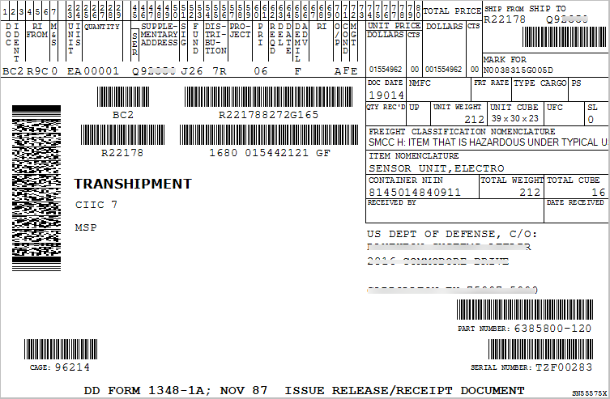
DD-1348-1A Fig. 1
  The DD-1348-1A includes important information that is vital for proper receipt processing (including the MILS document number, NIIN, SHIP TO, etc.)
Notes:
Next we’ll discuss the different types of open SIT and who’s responsible for each one.
POS – proof of Shipment – this falls under the issuer’s responsibility. If you are ATAC enabled, you will not have to post POS in CAV. If you aren’t using ATAC, you will have to post POS in CAV, which includes the SCAC, tracking #, shipment date, etc. Once POS is closed the SIT Status moves to POD.
POD – proof of Delivery – if you are using ATAC or another Transportation Carrier, then they will post POD. If you do a Local Delivery, then you are on the hook for POD. You must provide POD info. in CAV, which includes the same info. as POS plus the delivery date and the signature of the person that the package was delivered to at final destination. Once POD is closed the SIT Status moves to POR.
POR – proof of Receipt – In this case the Receiver is the CAV Vendor, so you must post POR (D6 TIR) in CAV using the correct information from the DD-1348 in order to close SIT.
OHA – On Hand Acknowledgement – this means that the asset ended up at a different location than what was on the Transportation Data. If you have OHA documents on your open SIT list this means you either received an asset that was supposed to go somewhere else and you need to post a receipt in CAV or you need to provide POS/POD info. in CAV.

Slide 18
Inbound SIT
Scenario 1 Solution Cont’d
  Scenario 1 - Redistribution Orders (RDOs)
  SOLUTION cont’d:
  If the qty. received differs from the qty. listed on the DD-1348, post a receipt for the material physically delivered and submit an SDR for any missing material within 7 days of receipt.
  ***Do not mark the SDR as Information Only***
  ***SDRs do not close SIT***
  Report issuers who are consistently missing paperwork
Notes:
Here are some tips for avoiding the common inbound SIT errors we just reviewed:]
As stated in the CAV SOW…
Ensure that the correct DD1348 paperwork is being delivered to the CAV keystroker at your site. If the keystroker doesn’t physically open the boxes when they arrive, make sure they are getting all paperwork included with each shipment.
Check the SHIP To field on the DD1348 and only proceed if your UIC is found
Report issuers who are consistently sending you shipments without the correct paperwork (this is the only way we’ll be able to address these issues)
Stop the SIT at the source by stopping whenever you’re unsure of how to receipt for something and contacting your CAV Analyst. Again, SIT becomes harder to close with time, so address issues as they arise.

Slide 19
Inbound SIT
Scenario 2 Solution
  Scenario 2 – Misidentified/Misdirected NIIN
  SOLUTION:
  Receive in J condition.
  If you can’t identify the NIIN shipped to you, receipt for NIIN MDJ111111 in CAV RP
  Send back to ATAC for rescreening within 7 days.
  File an info-only SDR within 7 days
  Exception: Classified NIINs have a different process (later in presentation)
Notes:
Another common inbound issue that we see is with Misidentified and/or Misdirected NIINs. A lot of CAV Vendors don’t want to post receipt when something seems off, but this creates aged SIT, which is always more difficult to close.
The main thing to remember here is always receive what you actually got. So for example, if the DD1348 on the box states NIIN A was shipped and the physical material inside the box is NIIN B, you’ll receipt for NIIN B. If you don’t have an open contract for this material, you’ll receive it in CAV in J condition under the Document number listed on the DD1348 with your UIC in the Ship To field. You’ll then issue the asset to ATAC in F condition for rescreening under the same document number that you posted your receipt.
If an asset is delivered to your site, but it is not a NIIN that you repair and should have gone somewhere else, receipt in CAV for what was physically received in J condition and then issue the asset to ATAC in F condition under the same document number you used to post your receipt. Do not issue to ATAC under an RCDN as this will open a new SIT issue and keep the original SIT issue open.
When ATAC posts their receipt, this will close SIT. That’s why it is so important to make sure that your receipt in J condition and issue in F condition are both posted under the same document number. If not SIT will not automatically close and we’ll have to find ATAC’s receipt in our system to manually close SIT. This takes time and becomes more difficult with age.
File an information only SDR within 60 days re: the NIIN misidentification or misdirection.

Slide 20
Inbound SIT
Scenario 3 Solution
  Scenario 3 – Receipt Reversals
  SOLUTION:
  Receipt reversals in CAV/CAV RP cause reopening of SIT
  Reach out to CAV Analyst before processing any reversals – you will require approval from your CAV Analyst to reverse any receipts in CAV RP that are over 30 days old
  If reposting receipt, make sure to post under original Source Document Number
  If reversal is needed and SIT can’t be closed, an LDD (Loss, Damaged, Destroyed) may be required

Slide 21
Classified SIT Scenarios

Slide 22
What is Classified SIT?
  Classified SIT or Security Coded SIT is determined by the CIIC Code
  CIIC stands for Controlled Inventory Item Code
  Below are the CIICs that are considered Classified/Security Coded

Slide 23
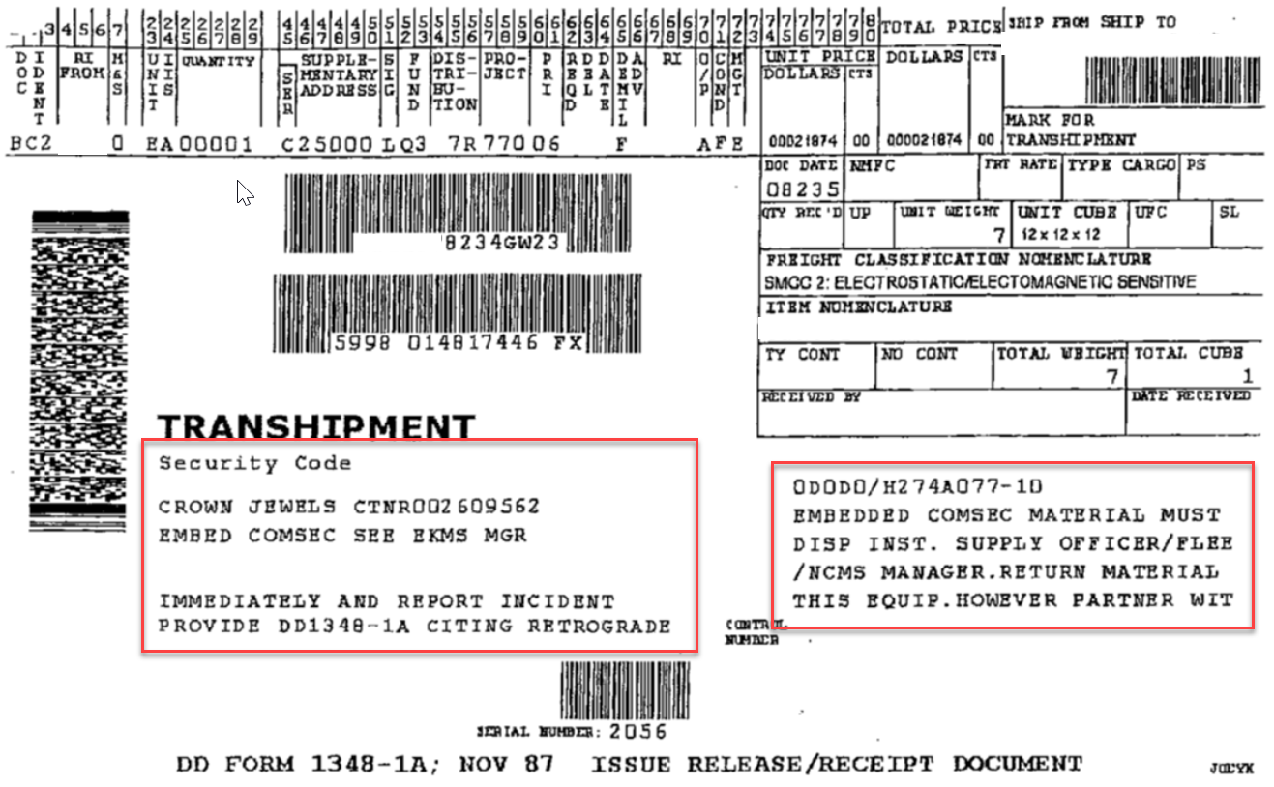
DD-1348 – Classified/Security Coded
  How do I know if the asset I received is Classified/Security Coded?
  Reference the DD-1348 and look for the CIIC Code or for Security Coded Notations

Slide 24
Classified SIT Scenarios
  Scenario 1 – Classified Shipping Process
  Shipping a classified asset differs from shipping a non-classified asset
  Scenario 2 - Local Delivery or USPS shipment of a Classified Asset
  Requires special documentation
  Scenario 3 – Misdirected Classified NIINs
  Please contact the CAV and SIT Analyst – do not follow process discussed in previous slides
Notes:
Some special things to consider when working classified SIT:
Do not use ATAC to ship classified assets. Instead, you’ll contact the cognizant DCMA Transportation office to arrange shipment.
If using Local Delivery to ship a classified asset, a signed Hand-to-Hand Custody transfer form (DD1907) is required.
All COMSEC Local Deliveries require an SF153 form. Samples of both of these forms are on the next two pages.
If you receive a misidentified asset and it’s classified, please contact the Supply Planner immediately.

Slide 25
Classified SIT
Scenario 1 Solution
  Scenario 1 – Classified Shipping Process
  SOLUTION:
  Do not use ATAC to ship classified assets
  The CAV Reporter shall contact the cognizant DCMA transportation office to arrange shipment of items excluded from ATAC transportation.
  A REPSHIP (Report of Shipment) is required prior to shipment of any classified assets.
  Do not include DD-1348s or classified markings on the outside of any packaging
  If you can’t find the REPSHIP POC in ERMS, contact Alex Sanchez or the SIT Team
Notes:
Some special things to consider when working classified SIT:
Do not use ATAC to ship classified assets. Instead, you’ll contact the cognizant DCMA Transportation office to arrange shipment.
If using Local Delivery to ship a classified asset, a signed Hand-to-Hand Custody transfer form (DD1907) is required.
All COMSEC Local Deliveries require an SF153 form. Samples of both of these forms are on the next two pages.
If you receive a misidentified asset and it’s classified, please contact the Supply Planner immediately.

Slide 26
Classified SIT
Scenario 1 Solution Cont’d
REPSHIP PROCESS
  Step 1
  The Advance REPSHIP asks if the receiver is ready and able to receive the asset
  It is prepared by the originator and sent to the receiver
  Step 2
  The Reply to the advance REPSHIP is the Receiver acknowledging the ability to receive the asset
  It is signed by the receiver and returned to the originator
  Do NOT ship assets without receiving a reply to the advance REPSHIP or if you receive a negative reply.
  The advanced REPSHIP and acknowledgement are NOT considered POS or POD.
Notes:
Some special things to consider when working classified SIT:
Do not use ATAC to ship classified assets. Instead, you’ll contact the cognizant DCMA Transportation office to arrange shipment.
If using Local Delivery to ship a classified asset, a signed Hand-to-Hand Custody transfer form (DD1907) is required.
All COMSEC Local Deliveries require an SF153 form. Samples of both of these forms are on the next two pages.
If you receive a misidentified asset and it’s classified, please contact the Supply Planner immediately.

Slide 27
Classified SIT
Scenario 1 Solution Cont’d
REPSHIP PROCESS
  Step 3
  The Tracking REPSHIP is required immediately after the asset ships.
  It is prepared by the originator and sent to the receiver.
  It contains the tracking information, mode of shipment, and estimated date of arrival.
  At this point, both the originator and receiver create a suspense file and should investigate any missing assets 24 hours after the estimated date of arrival.
  If the asset can’t be found an investigation is launched.
  Step 4
  The Receipt REPSHIP is the most important REPSHIP.
  It is signed by the receiver and sent to the originator.
  It is a signed receipt for this specific asset and valid Proof of Delivery (POD).
  In our Sample (next 2 slides) it is a signature at the bottom of the tracking REPSHIP.
Notes:
Some special things to consider when working classified SIT:
Do not use ATAC to ship classified assets. Instead, you’ll contact the cognizant DCMA Transportation office to arrange shipment.
If using Local Delivery to ship a classified asset, a signed Hand-to-Hand Custody transfer form (DD1907) is required.
All COMSEC Local Deliveries require an SF153 form. Samples of both of these forms are on the next two pages.
If you receive a misidentified asset and it’s classified, please contact the Supply Planner immediately.

Slide 28
SAMPLE
Advance Notification
FROM: ORIGINATOR
TO: FINAL DESTINATION
INFO: TRANSSHIPPING ACTIVITY
SUBJ: ADVANCE NOTIFIICATION OF REPORT OF SHIPMENT (REPSHIP)
Document Number, NSN , CIIC, nomenclature, serial number will be shipped to your facility. REPSHIP message including tracking information will be provide upon signed receipt of this form. Asset will not ship until confirmation of your ability to receive and store NIIN and S/N by signing and emailing this form back to: email address:________________________
Advance notification received by: (TYPE NAME)
Commercial Phone Number: _____________
Printed name:__________________________
Signature:_______________________________________________ Date:__________
Step 1 – Originator sends to Final Destination
Step 2 – Final destination signs and returns to originator

Slide 29
REPSHIP Message Requirements
Step 3 – Tracking REPSHIP Requirements
FROM: SHIPPING ACTIVITY
TO: DOMESTIC CUSTOMER OR TRANSSHIPPING ACTIVITY CLEARANCE AUTHORITY (OCEAN) OR CUSTOMER SERVICE BRANCH (CSB) (AIR) OR CONUS SEA TERMINAL
INFO: SPONSORING SERVICE ACCOUNTABLE SUPPLY ACTIVITY ULTIMATE CONSIGNEE/FINAL DESTINATION
SUBJ: REPORT OF SHIPMENT (REPSHIP)
1. SHIPMENT DATE WRITTEN AS A THREE-DIGIT DAY OF THE YEAR (JULIAN).
2. ETA WRITTEN AS A THREE-DIGIT DAY OF THE YEAR (JULIAN) (OBSERVE STANDARD TRANSIT TIME (STT) IF CONUS TRUCK SHIPMENT AND NO RDD IDENTIFIED).
3. REQUIRED DELIVERY DATE (RDD) OR DELIVERY DATE (DD) IF SPECIFIED.
4. CARRIER and TRACKING NUMBER
5. BILL OF LADING (BL) NUMBER (NOTES 1, 2, 3, 4).
6. MTX-GS SERVICE NUMBER (NOTES 1, 2, 3).
7. AIR RELEASE NUMBER (NOTES 1, 2, 3) OR FOR SURFACE SHIPMENTS, ETR NUMBER AND VESSEL NAME AND/OR VOYAGE DOCUMENT NUMBER.
8. SHIPMENT (CARGO) NAME (EXAMPLE: RECIEVER/TRANSMITTER, SERIAL NUMBER ,NIIN, Document number).
9. CONTAINER AND SEAL NUMBER (IF APPLICABLE): a. CONTAINER TCN. b. TOTAL WEIGHT OF CONTENTS c. ROUNDS, PIECES, WEIGHT, CUBE, CONDITION CODE, AND LOT NUMBERS (NOTE 4).
10. SECURITY RISK CATEGORY (SRC), (E.G., SECURITY RISK CATEGORY I, II, III, IV, U, SECRET, CONFIDENTIAL, NONE).
11. CONTROLLED INVENTORY ITEM CODE (CIIC).
12. TOTAL NET EXPLOSIVE WEIGHT (NEW).
13. HAZARD CLASSIFICATION(S).
14. DEPARTMENT OF DEFENSE IDENTIFICATION CODE/NAVY AMMUNITION LOGISTIC CODE (DODIC/NALC).

Slide 30
SAMPLE
Receipt Acknowledgement
Step 4 – Final destination signs and returns to originator
RECEIPT ACKNOWLEGENT
Document Number, NSN , CIIC, Nomenclature, Serial number
When asset is received at your facility , please confirm receipt of this asset by signing below and emailing this form back to: email address:____________________________
Receipt acknowledgment:
Printed name: ___________________________________________
Signature: ______________________________________________ Date:____________

Slide 31
Classified SIT
Scenario 2 Solution
  Scenario 2 – Local Delivery or USPS shipment of a Classified Asset
  SOLUTION:
  Requires the standard REPSHIP and DD-1348, in addition to a signed DD1907 form.
  The DD1907 form tracks the physical hand-off of assets from one person to another.
  Make sure to get a signature from the final destination when handing over any material.
  Keep these documents as KSDs.
Notes:
Some special things to consider when working classified SIT:
Do not use ATAC to ship classified assets. Instead, you’ll contact the cognizant DCMA Transportation office to arrange shipment.
If using Local Delivery to ship a classified asset, a signed Hand-to-Hand Custody transfer form (DD1907) is required.
All COMSEC Local Deliveries require an SF153 form. Samples of both of these forms are on the next two pages.
If you receive a misidentified asset and it’s classified, please contact the Supply Planner immediately.

Slide 32
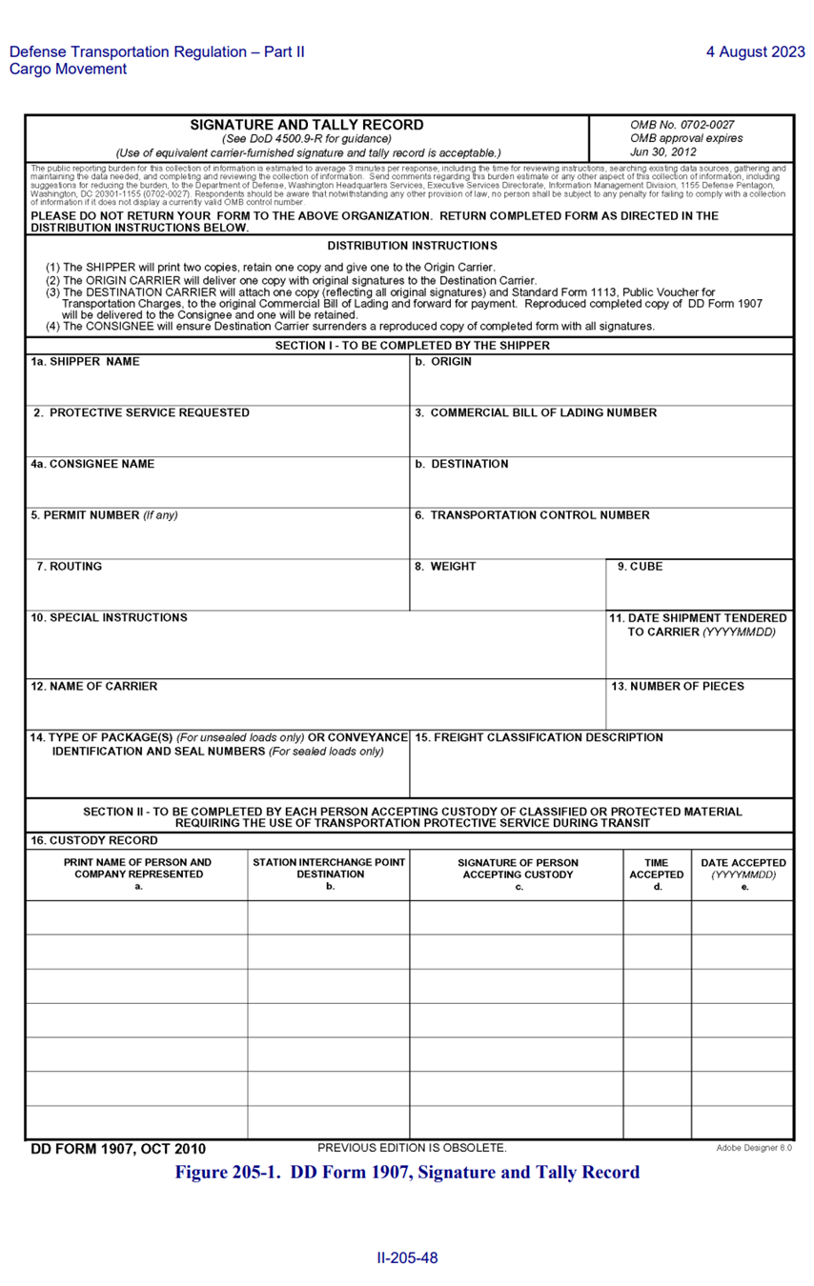
DD-1907 FORM

Slide 33
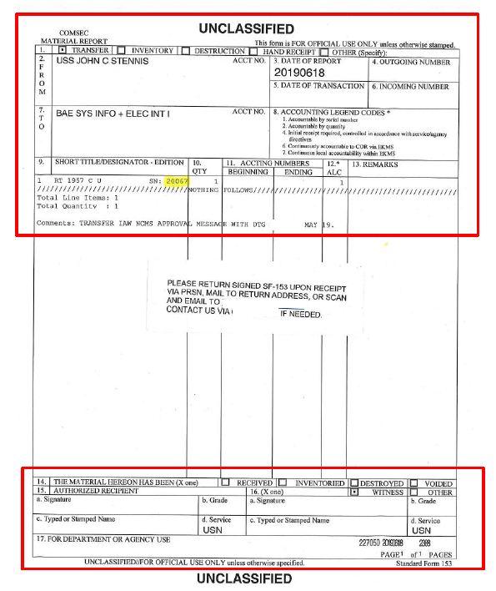
COMSEC SF153 Form

Slide 34
Classified SIT
Scenario 3 Solution
  Scenario 3 – Misdirected Classified NIINs
  SOLUTION:
  Please contact your CAV and SIT Analysts immediately if you receive a Classified/Security Coded NIIN mistakenly.
  To determine if a NIIN is classified refer to the DD-1348 for Classified/COMSEC notations.
  If you are still unsure if this asset is classified, please reach out to the CAV and SIT Analysts for direction.
  Do not use ATAC for any classified/security coded assets (refer to Slide 22 for CIIC Codes that fall into this group)
  Classified SIT Team will guide you through how and where to ship the misdirected assets
Notes:
Some special things to consider when working classified SIT:
Do not use ATAC to ship classified assets. Instead, you’ll contact the cognizant DCMA Transportation office to arrange shipment.
If using Local Delivery to ship a classified asset, a signed Hand-to-Hand Custody transfer form (DD1907) is required.
All COMSEC Local Deliveries require an SF153 form. Samples of both of these forms are on the next two pages.
If you receive a misidentified asset and it’s classified, please contact the Supply Planner immediately.

Slide 35
Classified SIT – Summary
  Classified SIT Summary
  Issuer and Receiver must have electronic communication before classified material is shipped.
  If issuer ships material before Advance Notification Reply from receiver, the receiver may reject material delivery.
  If classified material is received without proper paperwork, contact your CAV analyst and Classified SIT POCs for assistance.
    To determine if a NIIN is Classified/Security Coded refer to the CIIC Code slide in the Reference section and check the DD-1348 for notations.
  Per the CAV SOW, “The Contractor is required to also respond to inquiries received via phone calls, emails or letters from Navy representatives researching the status of open SIT. The Contractor will respond to these types of inquiries no later than the next working day after receipt of the inquiry.”

Slide 36
Questions
?

Slide 37
SIT Points of Contact
Monica Hodson (CAV SIT Team Lead) - monica.a.hodson.civ@us.navy.mil
Jason Bolen (CAV SIT Team Lead) - jason.c.bolen.civ@us.navy.mil
Sara Grafstrom (Classified SIT Team Lead) - sara.grafstrom.civ@us.navy.mil
Bridgette Orr (SIT Supervisor) - bridgette.p.orr.civ@us.navy.mil

